Slide 1
Interview Exercises
August 2021

Slide 2
Dubai Airports
Instructions
Dear Candidate,
The following exercises are to better understand your knowledge and experience in various areas. Good luck!
Please:
Limit yourself to the time associated to each area
Provide your answers in the Answer Sheet after each explanation
Let us know if you need anything

Slide 3
Dubai Airports
Contents
Exercise 1 - Environment Enablement 60 minutes
Exercise 2 - Data Management & Variable Engineering 60 minutes
Exercise 3 - Data Modeling & KPI Calculation 60 minutes

Slide 4
Dubai Airports
Exercise 1 - Environment Enablement
The Situation
Imagine that you are a Data Engineer at Dubai Airports and you have been assigned to work on the quick solution to provide key indicators about current pandemic situation.
The Project
Dubai Airports Operation team wants to understand how will current pandemic situation impact upcoming demand and better plan required resources on the ground. Team would like to know basic KPIs per country and identify those with best opportunity to increase number of flights to DXB.
Your Tasks
Deploy PostgreSQL database
Import data into stage schema (Raw data available at https://raw.githubusercontent.com/datasets/covid-19/master/data/time-series-19-covid-combined.csv)
Provide screenshot of table content from stage table on the next slide

Slide 5
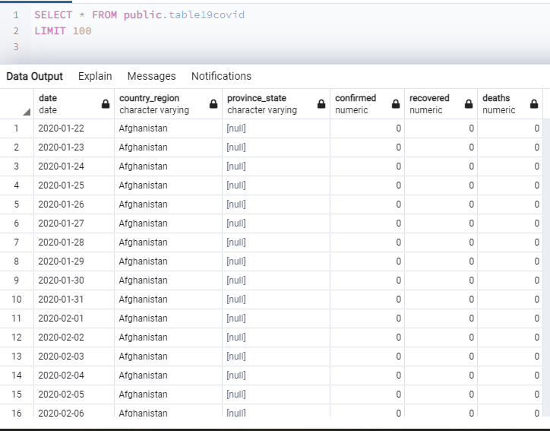
Dubai Airports
Exercise 1 – Answer Sheet

Slide 6
Dubai Airports
Exercise 2 - Data Management & Variable Engineering
Using PostgreSQL database engine from previous exercise and data set from stage schema, you need to identify top 10 countries with best recovery rate where recovery rate is a last 7 days decline of total active cases
For each of the 10 countries identified in previous step, provide following information as of today
Provide queries used to calculate required KPIs (in text format)
peak_date | date when peak happened (maximum number of active cases)
peak_active | number of active cases at peak
cases | number of total reported cases (as of today)
active | number of active cases (as of today)
recovered | number of patients recovered (as of today)
deaths | number of patients died (as of today)
gross_adds | number of reported cases from day before

Slide 7
Dubai Airports
Exercise 2 – Answer Sheet
SQL Query:
CREATE TEMP TABLE tbl_CHK AS
select * from(
SELECT *,case when
(select max(recovered) from table19covid where
country_region = A.country_region and
DATE = A.DATE) >
(select max(recovered) from table19covid where
country_region = A.country_region and
DATE = A.DATE-1) then 'true' else 'false' end chk,
(select max(recovered) from table19covid where
country_region = A.country_region and
DATE = A.DATE) -
(select max(recovered) from table19covid where
country_region = A.country_region and
DATE = A.DATE-1) deff
from
(SELECT country_region,recovered,DATE FROM public.table19covid
WHERE DATE BETWEEN (SELECT MAX(DATE)-6 FROM table19covid) AND (SELECT MAX(DATE) FROM table19covid)
AND recovered IS NOT NULL ) A )AA

Slide 8
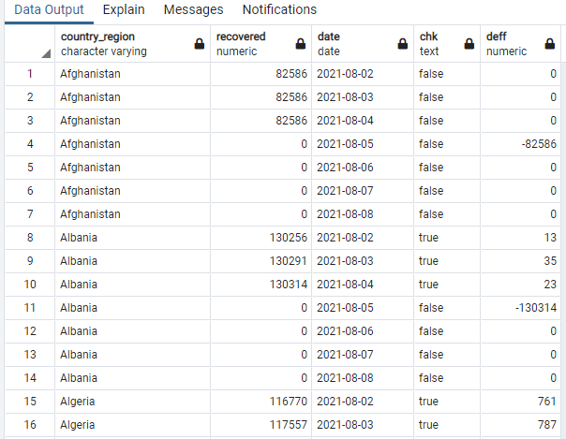
Dubai Airports
Exercise 2 – Answer Sheet
Result Set Output:

Slide 9
Dubai Airports
Exercise 2 – Answer Sheet
SQL Query:
CREATE TEMP TABLE my_country AS
select country_region from(
select country_region,deff from tbl_CHK
where country_region not in (
select country_region from tbl_CHK
where chk = 'true'
group by country_region)
order by 2 )a
limit 10

Slide 10
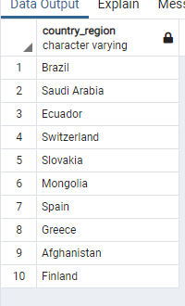
Dubai Airports
Exercise 2 – Answer Sheet
Result Set Output:

Slide 11
Dubai Airports
Exercise 2 – Answer Sheet
SQL Query:
select *,(select (max(confirmed)+max(recovered)+max(deaths)) from public.table19covid where
country_region =A.country_region and
DATE = A.peak_date-1) gross_adds
from (
select country_region,max(confirmed) peak_active ,(select max(DATE) from public.table19covid where country_region =A.country_region
and confirmed =max(A.confirmed)) as peak_date
-- i observed from the data that it was already taking SUM with a previous date.
-- thats why i use MAX not sum
,(max(confirmed)+max(recovered)+max(deaths)) as cases
,max(confirmed) as active
,max(recovered) as recovered
,max(deaths) as deaths
from public.table19covid A
where country_region in ( select * from my_country )
group by country_region )A

Slide 12
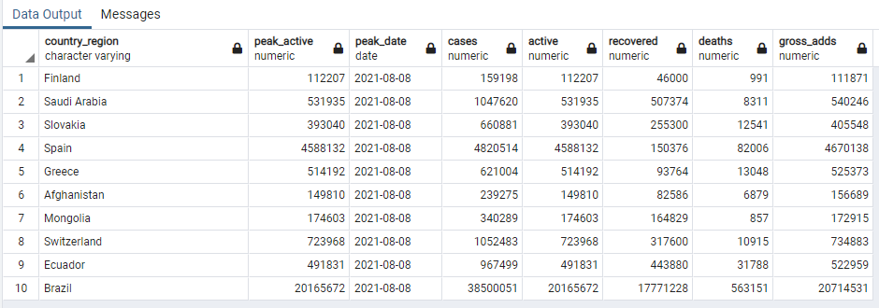
Dubai Airports
Exercise 2 – Answer Sheet
Result Set Output:

Slide 13
Dubai Airports
Exercise 3 - Data Modeling & KPI Calculation
The Project
Dubai Airports Operation team create a plan for stand utilization every month. Each stand can be assigned only to certain types of aircraft, based on aircraft wingspan and number of passengers on the flight. Moreover, due to unexpected circumstances (flight delay, bad weather, stand unavailability, etc..) it is possible to assign different stand to a particular flight on the day of operation. Every 6 months, team perform stand utilization plan validation, comparing originally created plan with actuals and analyze deviations.
Considering that all historical data is available in the system, create ER diagram of data model which would be the most suitable for running the validation process.
Define KPI or Data set which would empower team to have clear visibility around deviations (actual vs planned)
Provide sudo code which could be used to provide KPI or data set using data model defined in first bullet point

Slide 14
Dubai Airports
Exercise 3 – Answer Sheet
ER Diagram:
Airlines
(PartyRole)
Schedules
(Plan)
Type OF aircraft (info)
(Master Data)
Filght Shedules
(Master Data)
Filghts
(Movement)
Passengers
(PartyRole)
Facilities
(e.g Gate)
Ground-Handling Events
(Events)
Resources
(PartyRole)
e.g Staff
Stand

Slide 15
Dubai Airports
Exercise 3 – Answer Sheet
KPIs:
• Planned schedule (including flight number, aircraft type, number of seats, route and scheduled time of operation);
• Actual schedule (including flight number, aircraft type, number of seats, route and actual time of operation);
• Planned times on and off stand (stand departure with in 15 minutes , outliers' aircraft );
• Actual times on and off stand (stand departure delays greater than 15 minutes , outliers' aircraft );

Slide 16
Dubai Airports
Exercise 3 – Answer Sheet
Pseudo code:
• Planned schedule:
Get the data from aircraft Info table (like flight number, aircraft type number of Seats )
And route and scheduled get from Flight Schedules table
• Actual schedule:
Get the data from aircraft Info table (like flight number, aircraft type number of Seats )
And route get from Flight Schedules table and Actual will give the Ground-Handling Events.
• Planned times on and off stand:
Get from Schedules table and Facilities assign the stand those aircraft whose departure is under or equal to the Planned times taken from Ground-Handling Events. Also identify outliers' aircraft ( not certain types of aircraft on that Stand ) taking form Ground-Handling Events and Facilities (also the reasons)
• Actual times on and off stand:
Get from Schedules table and Facilities assign the stand those aircraft whose departure greater than the Planned times taken from Ground-Handling Events. Also identify outliers' aircraft ( not certain types of aircraft on that Stand ) taking form Ground-Handling Events and Facilities (also the reasons)

